Slide 1

2018 Stock Market Data
By: Bingxuan Hu and Adam Stein

Slide 2

Description of the Data
Our dataset includes 215 predictor variables from 2477 different stock tickers
We removed many 72 variables from the dataset, some because they were categorical and some because there were many blanks in the dataset
We removed 1915 stock tickers because they had many blanks in them
The response variable chosen is Price Var, which is the percent the stock increased or decreased during the year 2018
Some examples of predictor variables are Price to Earnings Ratio, Cash Per Share, Debt, Operating Costs etc.
Notes:
Remove variables and observations because of blanks; sector(categorical)
Y variables

Slide 3
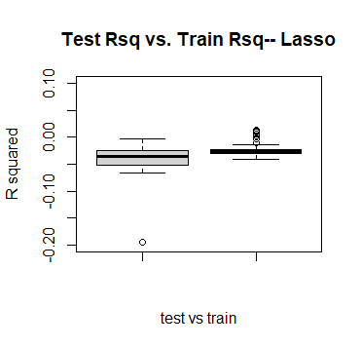
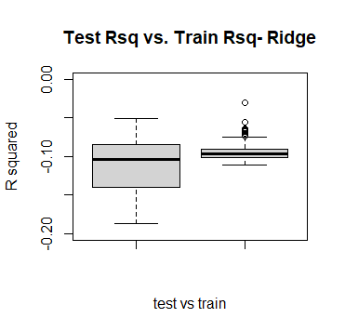
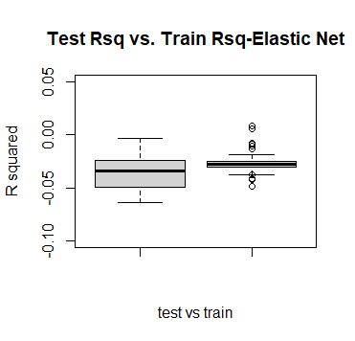
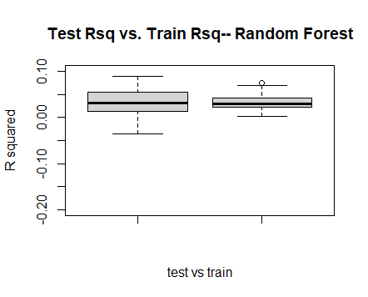
Boxplots for R^2 Testing and Training
Lasso
Ridge
Elastic
Net
Random
Forest
Notes:
Outliers,
Negative:The negative R-squared value means that your prediction tends to be less accurate that the average value of the data set over time.
R2 compares the fit of the chosen model with that of a horizontal straight line (the null hypothesis). If the chosen model fits worse than a horizontal line, then
R2 is negative. Note that R2 is not always the square of anything, so it can have a negative value without violating any rules of math.
R2 is negative only when the chosen model does not follow the trend of the data, so fits worse than a horizontal line.
Random Forest

Slide 4
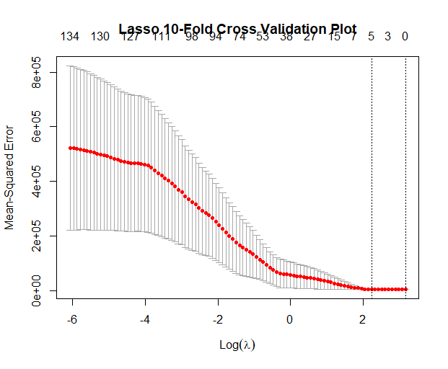
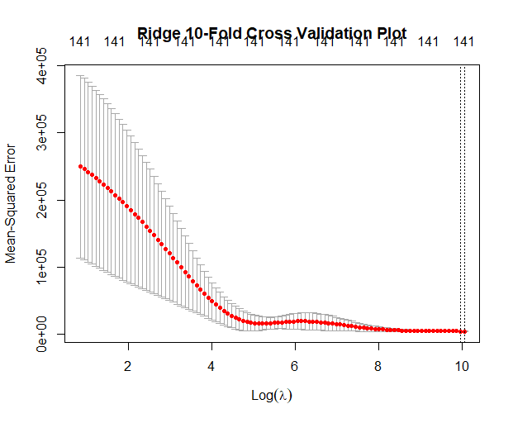
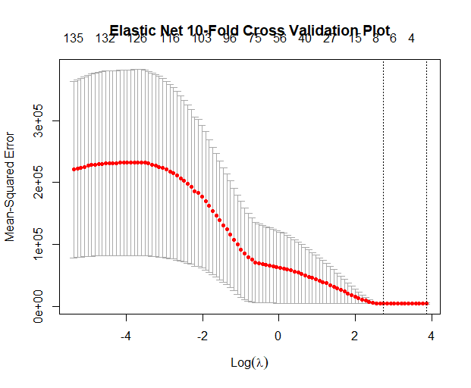
10-Fold Curves
Lasso
Ridge
Elastic Net
Time to Cross-Validate
1.36 Seconds
Time to Cross-Validate:
0.41 Seconds
Time to Cross-Validate:
1.04 Seconds
Notes:
MSE: Extremely large(100,000), decreases dramatically as lambda increases(most predictors are bad)
Time:Ridge: the fastest
Lasso is the slowest

Slide 5
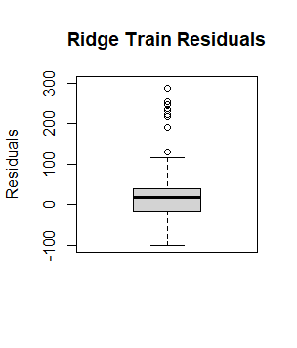
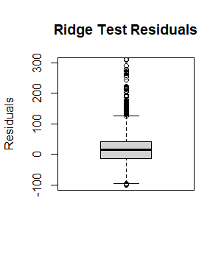
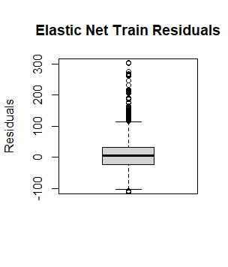
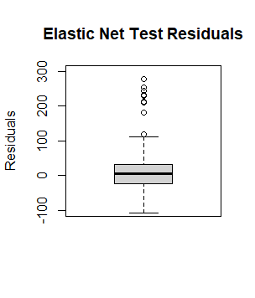
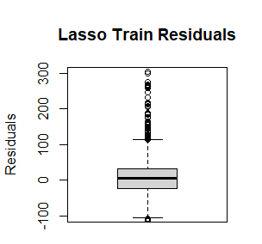
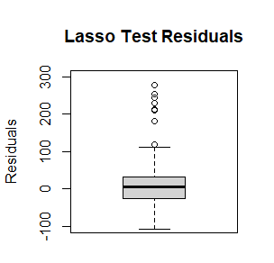
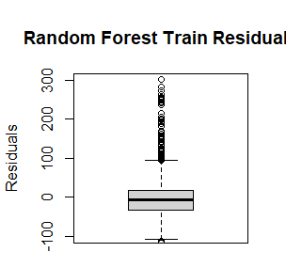
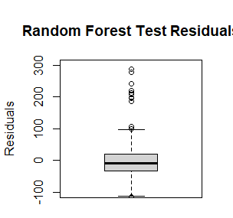
Boxplots for Training and Testing Residuals
Notes:
Test results are not so different from the train results
Medium: around 0; quartiles:(-50,50); extremes(-100,100)
Zoom in, Elastic net and Lasso work slightly better;

Slide 6
Type of Regression
90% Test R^2 Based on 100 Samples
Time To Fit Model
Ridge
(-0.1517765,-0.1047856)
.06 Seconds
Lasso
(-.04950844,-.03169585)
.01 Seconds
Elastic-Net
(-0.04756518,-0.03179985)
.02 Seconds
Random Forest
(.03458895,.04455399)
64.84 Seconds
Notes:
Based on the time to fit the models and the 90% confidence interval for R^2 over 100 samples, it seems other than the random forest, which took by far the longest to fit and had the best results based on the 90% R^2 Confidence interval, the quicker the model took to run, the greater the predictive performance of that regression type. For instance the lasso model took the quickest to run over the entire data set and had the greatest predictive performance other than the random forest

Slide 7
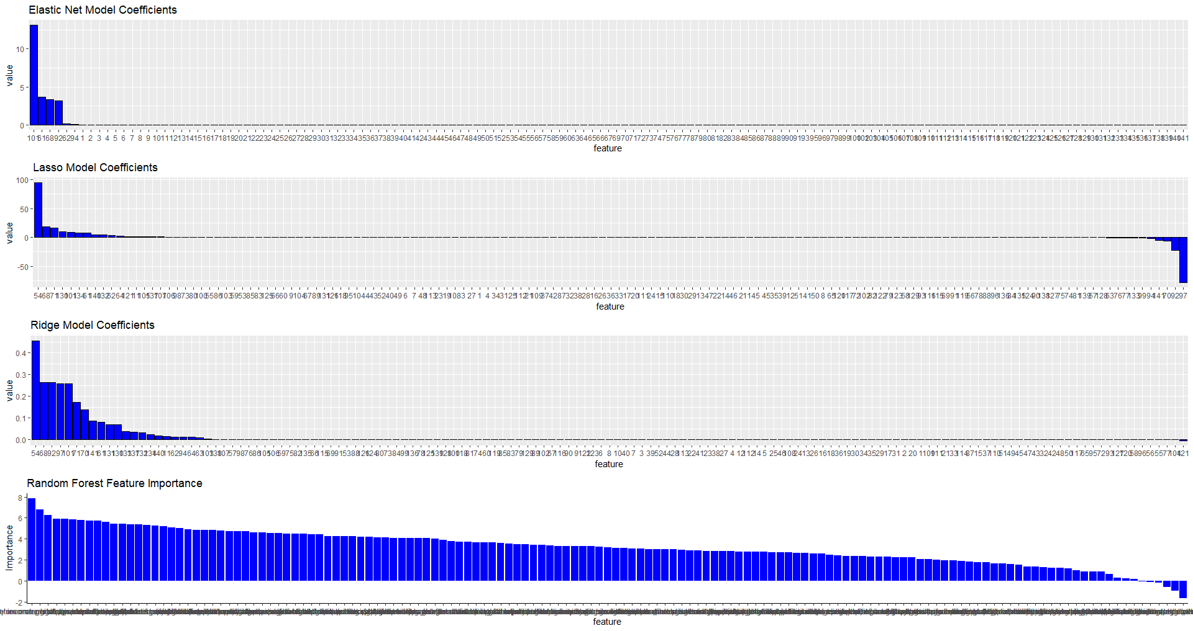
Bar Plots of Estimated Coefficients
Notes:
For random forest the most important factors are net income per share, return on tangible assets and 3 yr revenue growth per
share
For the ridge dividend yield, debt ratio and debt to assets were the top 3, the least important were capex per share, capex to depreciation and operating cash flow sales ratio
For the lasso, divident yield, debt ratio and debt to assets were also top 3, same least important
For the elastic net, intangibles to total assets, asset turnover and debt ratio were top, only 6 features had any value, none were negative

Slide 8

Concluding Thoughts
Notes:
Our model did not have much predictive ability our variables. One reason we believe this may be the case is because our dependent variable was a change in the stock price over the course of a year, while many of our independent variables were stagnant numbers that were recorded at the end of the given year. It may have improved if we had the change in these numbers rather than the isolated statistics. Either way, we learned a lot going through this process

